Slide 1
Form Based Authentication

Slide 2
Introduction
Form based Authentication :
In built libraries, controls and techniques for security and session management.

Slide 3
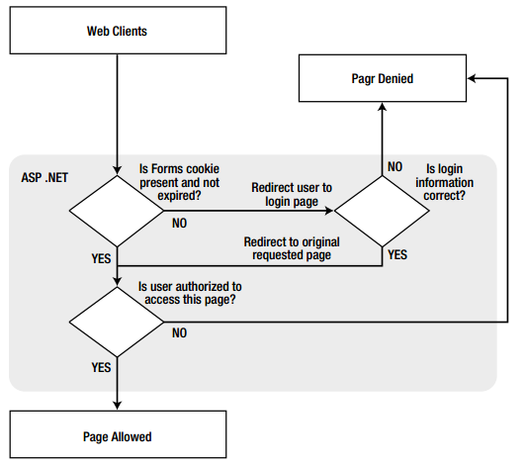
Overall Idea

Slide 4
Steps
Set the authentication mode to forms authentication in the web.config file.
Restrict anonymous users from a specific page or directory in your application.
Create the login page.

Slide 5
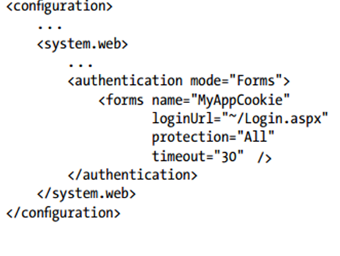
Web.config Settings
You define the type of security in the web.config file by using the <authentication> tag.

Slide 6
Form Elements
Name : The name of the HTTP cookie to use for authentication.
loginURL : Your custom login page, where the user is redirected if no valid authentication cookie is found.
Protection : The type of encryption and validation used for the security cookie.
Timeout : Cookie Expiry timeout.

Slide 7
Authorization Rules
If you make these changes to an application’s web.config file and request a page, you’ll notice that nothing unusual happens, and the web page is served in the normal way. This is because even though you have enabled forms authentication for your application, you have not restricted anonymous users.

Slide 8
To control who can and can’t access your website, you need to add access-control rules to the <authorization> section of your web.config file.

Slide 9
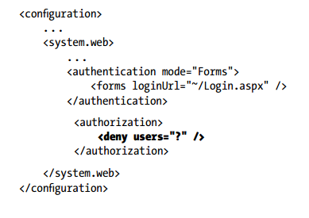
Example

Slide 10
The question mark (?) is a wildcard character that matches all anonymous users. By including this rule in your web.config file, you specify that anonymous users are not allowed.
If you request a page in the application directory now, ASP.NET will detect that the request isn’t authenticated. It will then redirect the request to the login page that’s specified by the login URL attribute in the web.config file.

Slide 11
Controlling Access to Specific Directories
Make web.config file for specific directory and mention your Authorization rules in that web.config file.

Slide 12
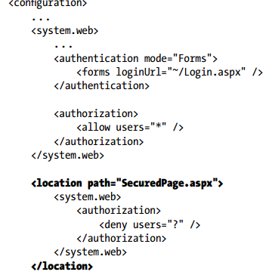
Controlling Access to Specific Files

Slide 13
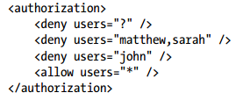
Controlling Access for Specific Users
Allow all authenticated users but do not allow matthew, sarah and john.

Slide 14
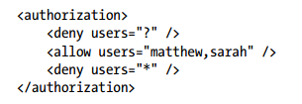
What does this rule mean ?

